Slide 1
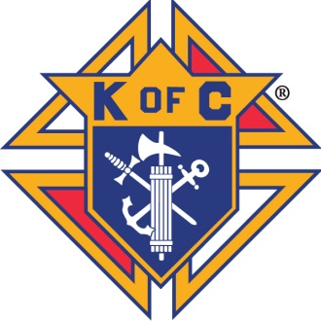
Knights of Columbus Safe Environment Program
State Advocates Meeting
Saturday, June 18, 2016
Dallas/Ft. Worth Airport Marriott
Dallas, Texas
Brian J. Gedicks
Associate General Counsel

Slide 2
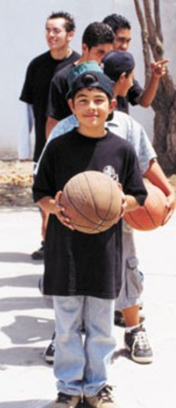
Why are Safe Environments a Top Priority of the Knights of Columbus?
Majority of councils are parish-based serving families with children and vulnerable adults
Renewed focus on family and parish life in Building the Domestic Church While Strengthening Our Parish
Knights of Columbus is a Youth Serving Organization

Slide 3
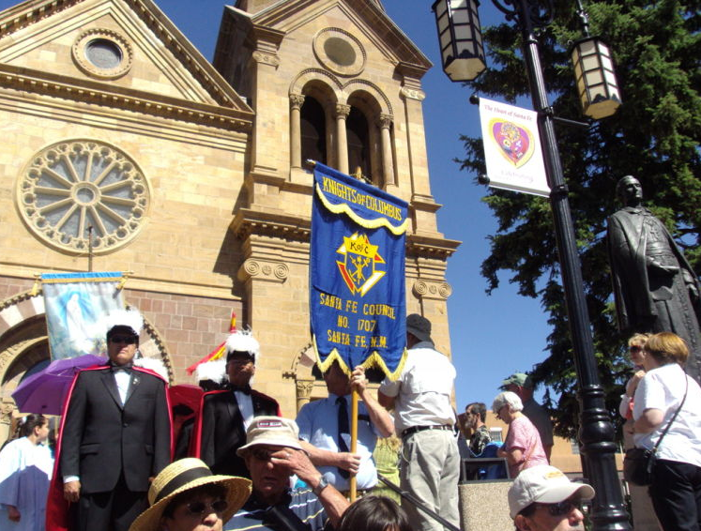
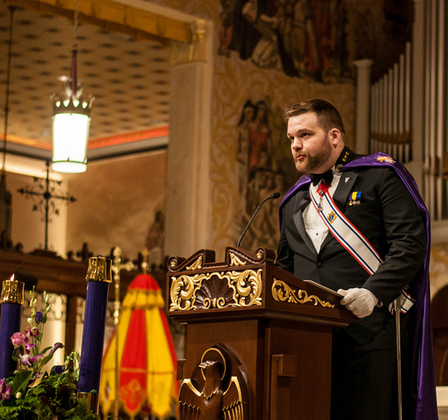

Majority of councils are parish-based
The Knights of Columbus serves in a diocese only at the invitation of the local Bishop.
The Knights of Columbus serves in a parish only at the invitation of the Pastor.

Slide 4

Building the Domestic Church/ Strengthening Our Parish
In 2015, Supreme Knight Carl Anderson announced the Order’s far-reaching new Domestic Church initiative.
New programs and activities that build up families, strengthen parishes, promote the New Evangelization, and grow the Order.

Slide 5
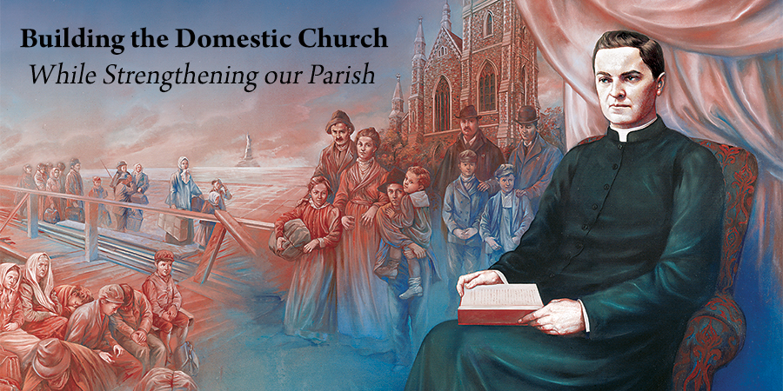
The Supreme Knight is encouraging members of Knights of Columbus to help build the new alliance between families and parishes called for by Pope Francis through Building the Domestic Church While Strengthening Our Parish and fully realize Fr. McGivney’s original vision.

Slide 6
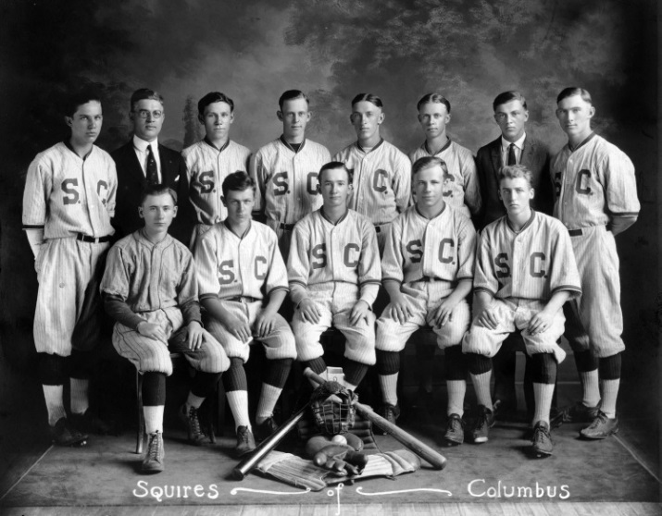
Knights of Columbus is a Youth Serving Organization
Since the early days of its founding through its protection of the orphans of its members, the Knights of Columbus has worked to provide for the welfare of families and young people.

Slide 7
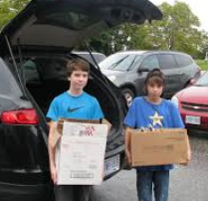
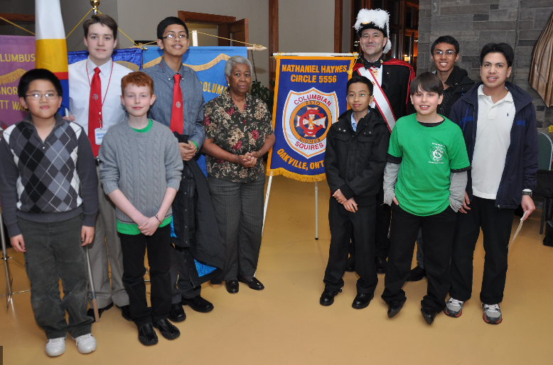
Knights of Columbus is a Youth Serving Organization
Today, Knights of Columbus encourages young people as they follow their paths to adulthood through its programs and activities, including:
Columbian Squires
sponsorship of sports activities and championships
volunteer opportunities
educational programs

Slide 8
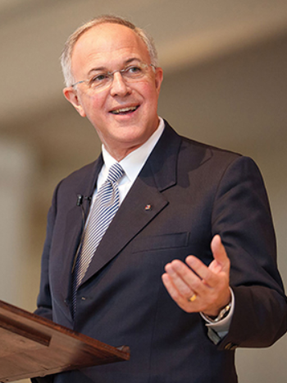
“Tone At The Top”
All children deserve a safe environment. We as Knights of Columbus are committed to providing such an environment.
. . .we have no higher priority than the protection of our children. And as Knights of Columbus, we take this responsibility very seriously.
We strive to maintain the highest standards regarding the protection of young people.

Slide 9
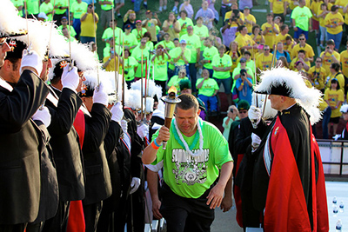
Safe Environments are a TOP Priority of the Knights of Columbus
All members have a moral responsibility to look out for and protect children and vulnerable persons
The Order has a moral obligation to protect its volunteers
All members are responsible to safeguard the good name of the Knights of Columbus

Slide 10
Diocesan and Parish Policy
The foundation of the Knights of Columbus Safe Environment Program is that all members of the Knights of Columbus comply with their local parish and diocesan safe environment program requirements.

Slide 11
Diocesan and Parish Policy
It is the responsibility of all members of the Knights of Columbus to determine their parish and/or diocesan safe environment requirements and to comply with them.

Slide 12
Diocesan and Parish Policy
This means that all members must complete all diocesan safe environment program requirements, including training and background checks, as required by the local diocese and parish.

Slide 13
Diocesan and Parish Policy
All members of the Knights of Columbus with questions about these local parish and diocesan requirements are asked to contact their parish and/or diocesan safe environment program coordinator.

Slide 14
Knights of Columbus Policy
Over and above compliance with local parish and diocesan safe environment requirements, certain members of the Knights of Columbus are required to comply with the requirements of the Knights of Columbus Safe Environment Program.

Slide 15
Knights of Columbus Policy
The Board of the Knights of Columbus has identified specific officer roles that require members assuming such roles to take online training and, in some cases, undergo a background check every two years.

Slide 16
Knights of Columbus Policy
State Deputy- Training Only
State Youth Director - Training and Background Check required
State Squires Chairman - Training and Background Check required
Grand Knight - Training Only (Background check required only if member is serving in an additional youth serving role)
Faithful Navigator - Training only where Faithful Navigator’s assembly sponsors a Columbian Squire Circle
Youth Director - Training and Background Check required
Columbian Squires Chairman - Training and Background Check required
Chief Counselor - Training and Background Check required
Committee/Adult Counselors - Training and Background Check required

Slide 17
Knights of Columbus Policy
Members occupying one or more of these roles are required to complete these Knights of Columbus Safe Environment Program requirements within 30 days of written notification of their need to comply.

Slide 18
Knights of Columbus Policy
Members who do not comply with Safe Environment Program requirements within 45 days will be deemed ineligible to serve as a youth leader within the Knights of Columbus and will be automatically removed.
The Grand Knight will be advised of member’s ineligibility and will have the option to appoint a different member.

Slide 19
Knights of Columbus Policy
State Deputies Have Responsibility to Maintain Safe Environments in their Jurisdictions

Slide 20
Knights of Columbus Policy
State Deputies should delegate this responsibility to State Advocates and State Squires Chairmen
State Advocates – coordinate with District Deputies to work with Grand Knights and Youth Directors
State Squires Chairman – work directly Chief Squires Counselors and Squires Counselors

Slide 21
Knights of Columbus Policy
State Deputies, State Advocates, State Squires Chairman are responsible to:
ensure that every council completes and submits its Form 365 and every circle completes and submits its Form 468 in a timely manner;
complete the online training so that they will lead by example and have working knowledge of the policies of the Knights of Columbus Safe Environment Program;
gain understanding of how to access the online Praesidium Armatus administration dashboard to track the overall compliance for each jurisdiction; and
actively monitor compliance of councils, and follow up with District Deputies and Grand Knights to ensure that they are doing the same with their members.

Slide 22
Knights of Columbus Policy
State Deputies, State Advocates, and State Squires Chairman also have access to the administration dashboard through Praesidium to monitor and enforce the overall compliance of members within each jurisdiction in the United States, Canada, and the Philippines.

Slide 23


Knights of Columbus Safe Environment Program
In 2015, Knights of Columbus partnered with Praesidium Inc., an organization with more than 25 years of experience in safeguarding youth.
Through this partnership, members are provided with the most up-to-date resources available to keep children safe, including online training, compliance dashboard, background screenings, and reporting services.

Slide 24
Knights of Columbus Safe Environment Program
WRAP UP

Slide 25

Compliance With Knights of Columbus Policy
Four Principal Policy Books

Slide 26
Praesidium Armatus Online Training
The Knights of Columbus Safe Environment Program consists of three key online training components for members serving in youth leader and officer roles:
“Meet Sam,” which addresses the issue of sexual abuse awareness;
“Duty to Report,” which presents legal reporting obligations; and
“Know Your Policies,” which covers the Knights of Columbus Safe Environment Program policies and procedures.

Slide 27
Praesidium Armatus Online Training
These training modules cover best practices for child abuse prevention and detection.
Paper and Pencil “Self-Study” Guides are available for those who do not have internet access or who prefer hard copy study guides.

Slide 28
Reporting Requirements
All members have an obligation to report suspected or actual abuse to local law enforcement if they have a reasonable basis to believe that there may be abuse taking place.
All members in Board designated roles (State Deputy, State Squires Chairman, State Youth Directors, Grand Knights, Faithful Navigators if their Assembly sponsors a Circle), and Squires Counselors are MANDATORY reporters under the Knights of Columbus Safe Environment Policy.

Slide 29
Reporting Requirements – K of C Hotline
1-844-KOFC-SAFE (1-844-563-2723)
For suspected or actual risks relating to safe environment
The Knights of Columbus Safe Environment Hotline is maintained exclusively for the Knights of Columbus by Praesidium and is staffed by customer service representatives who are independent of the Knights of Columbus.
The caller’s identity and the information shared is confidential.

Slide 30
Reporting Requirements
Suspicion or Knowledge of Abuse
It is the policy of the Knights of Columbus that all members who suspect or have knowledge of abuse by a member of the Knights of Columbus should immediately notify law enforcement and call the Knights of Columbus Safe Environment Hotline directly at:
1-844-KOFC-SAFE (1-844-563-2723)

Slide 31
Reporting Requirements
Knowledge of Arrest, Conviction, or Sex Offender Registry
Any member of the Knights of Columbus having knowledge of a member who has been arrested or convicted of a sex related offense, or who is listed on a state sex offender registry, should immediately call the Knights of Columbus Safe Environment Hotline at:
1-844-KOFC-SAFE (1-844-563-2723)

Slide 32
Membership Policy
Suspension For Conviction or Sex Offender Registry
A member who has been convicted of a sex related offense (misdemeanor or felony or the equivalent thereof) or who is listed or required to be listed on a sex offender registry, shall be automatically suspended for an indefinite period of time by the Knights of Columbus Board of Directors regardless of when the conviction or sex offender registration occurred.
The suspended member shall retain the right to petition the Board.

Slide 33
Membership Policy
Suspension When Subject to Credible Allegations
A member who is subject to allegations of sexual misconduct, which have the appearance of credibility, or is arrested on a charge of a sex related offense (misdemeanor or felony or the equivalent thereof) shall be suspended by the Knights of Columbus Board of Directors for an indefinite period.
This regulation shall apply regardless of when the misconduct allegedly occurred.
The suspended member shall retain the right to petition the Board.

Slide 34
Membership Policy
Diocesan/Parish Actions
Knights of Columbus follows the lead of actions taken and decisions made by local dioceses and parishes concerning membership in the Knights of Columbus.

Slide 35
Knights of Columbus Safe Environment Program
KofC Safe Environment Program Line
For answers to general questions and concerns, please call the Knights of Columbus Safe Environment Program Line at:
(203) 800-4940

Slide 36
Questions and Discussion

Slide 37
Building the Domestic Church/Strengthening Our Parish - Youth Programs
Councils should move toward greater integration into the life of parishes
Councils should phase out duplicative programs that may compete with parish activities
Instead, use resources of time, talent and money to strengthen parish-sponsored programs
Knights of Columbus is currently supporting existing circles, but councils/assemblies in the U.S. and Canada are asked to not start any new circles
Instead, members are asked to work closely with parish-based youth ministries in coordination with local pastors

Slide 38
If I have already taken another organization’s youth protection training and background check, why do I have to complete the requirements of the Knights of Columbus Safe Environment Program?
Because the Knights of Columbus does not rely on other organizations to fulfil its responsibility for protecting children and young people.
The Knights of Columbus is responsible for ensuring that its members know Knights of Columbus Safe Environment/Youth Protection Policies and Procedures.
Knights of Columbus conducts and maintains its own original background checks on those members serving in youth leader roles.
Knights of Columbus is not allowed to access confidential, privileged, and otherwise legally protected files and records of other organizations.
Knights of Columbus protects and preserves each member’s record of completion to protect the member and the Order.

